Slide 1
ENGI 301 Puppeteer Robot Proposal
2/13/2023
Lily Scholnik

Slide 2
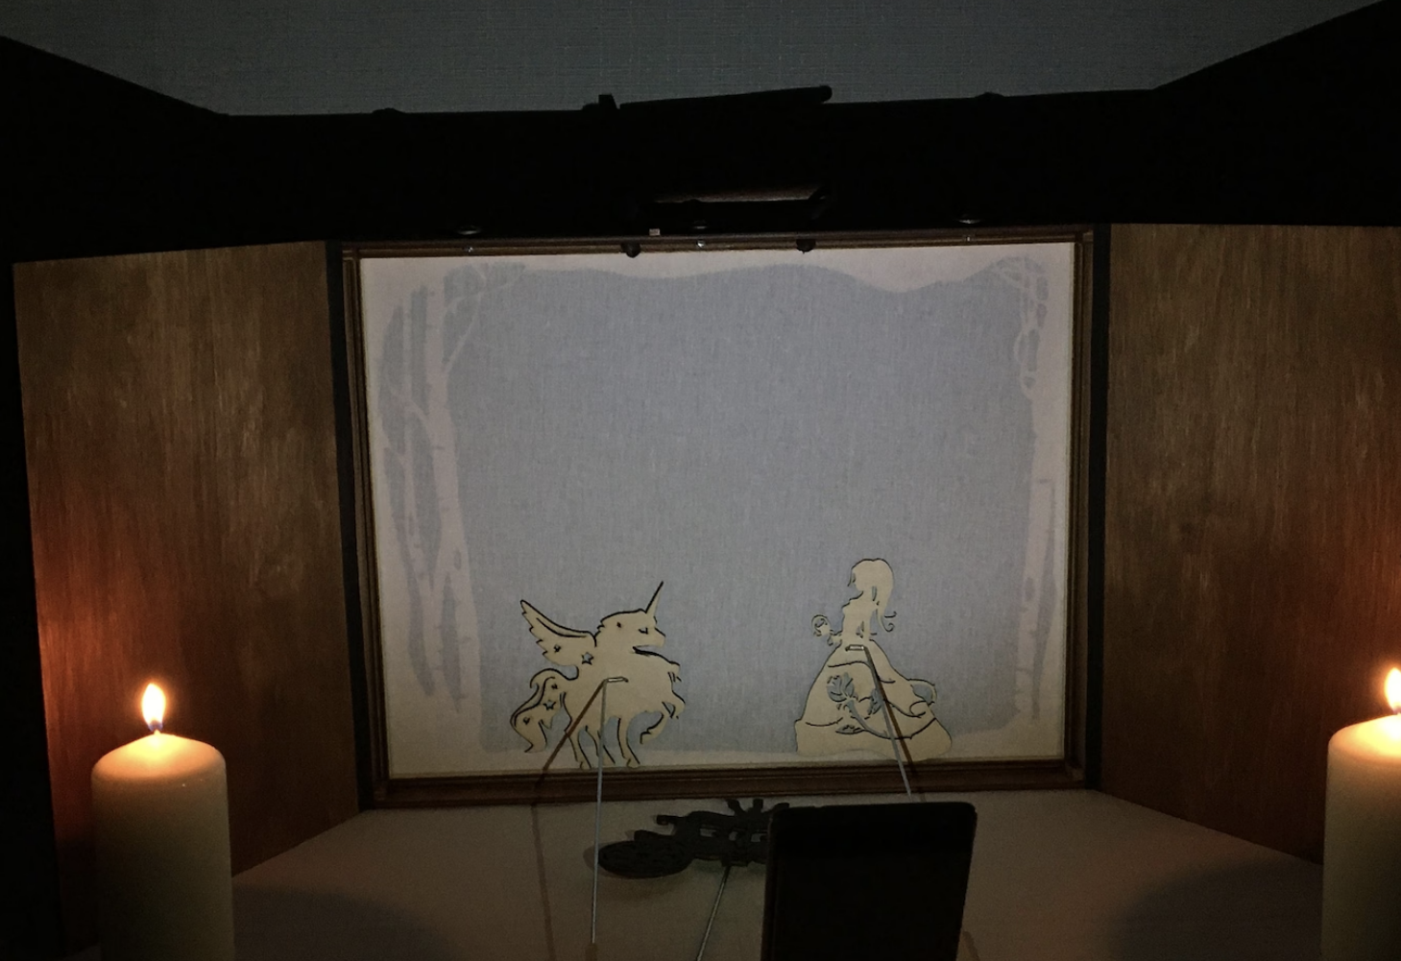
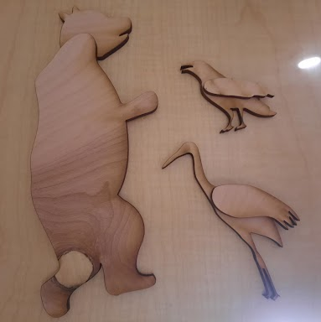
Background Information
Proposed project:
Button activated, pre-programmed functionalities to support a single-operator shadow puppet theater production
Functionalities:
3 servo animated puppets
2 sound effects on a USB speaker
1 puppet moved using two joint arm (3 pre-programmed movement sequences) → emulating 2D plotter
Referencing the following projects:
Doug Hebda’s PocketBeagle CNC Using BeagleG → https://www.hackster.io/dah8/pocketbeagle-cnc-using-beagleg-070f2f
Tyler Pitts’ 2D Plotter Using PocketBeagle → https://www.hackster.io/tjp4/2d-plotter-using-pocketbeagle-47db39
Samuel Sarver’s Robot VS Human Connect 4 → https://www.hackster.io/samuelmsarver/robot-v-s-human-connect-4-eca0b5
Why:
I am doing an independent study in which I am adapting folklore to shadow puppet theater and I do not have enough hands to adapt the piece as I would like. The original story involves multiple characters on screen at once, and dynamic movements of puppets would really bring the show to life. Having the protagonist puppet controlled by the PocketBeagle would additionally further the moral of the story during outreach performances.
Shadow puppet screen with manually controlled puppet examples
The three puppets to be animated with servos
Notes:
Doug Hebda’s PocketBeagle CNC Using BeagleG → https://www.hackster.io/dah8/pocketbeagle-cnc-using-beagleg-070f2f
Tyler Pitts’ 2D Plotter Using PocketBeagle → https://www.hackster.io/tjp4/2d-plotter-using-pocketbeagle-47db39
Samuel Sarver’s Robot VS Human Connect 4 → https://www.hackster.io/samuelmsarver/robot-v-s-human-connect-4-eca0b5

Slide 3
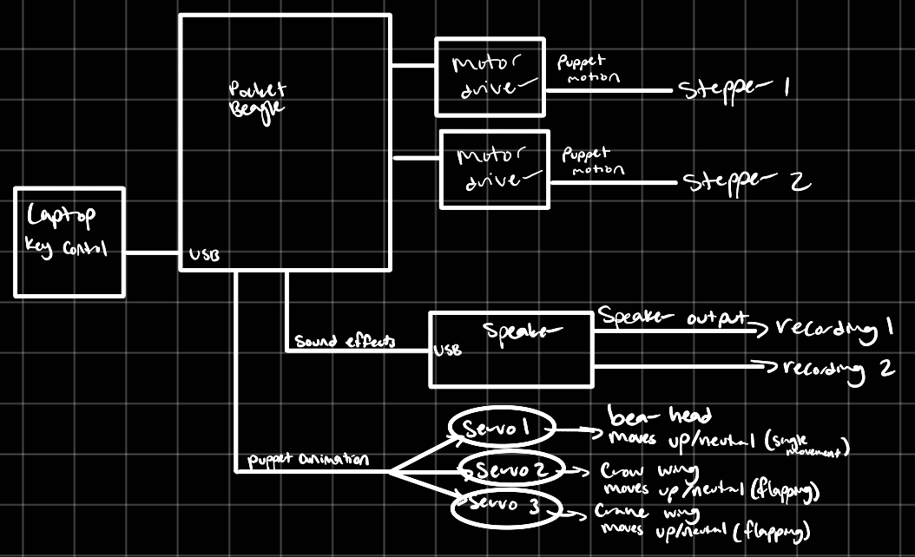
System Block Diagram
Need Moderate Level of Detail

Slide 4
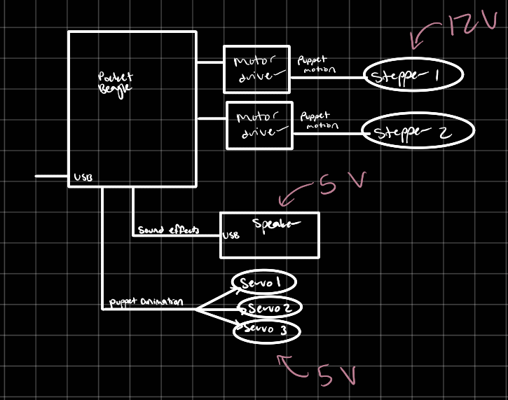
Power Block Diagram

Slide 5
Components / Budget ⇒ total: $89.11
Component | Need to Buy | Cost
Stepper motors https://www.amazon.com/dp/B0B38H2ZMR | 2 | 7.99
Motor drivers https://www.amazon.com/HiLetgo-Stepstick-Stepper-Printer-Compatible/dp/B07BND65C8 | 2 | 2.04
Servos https://www.amazon.com/FEETECH-Continuous-Rotation-Matching-Helicopter/dp/B0B42KLJ9G | 3 | 5.40
USB Speaker https://www.amazon.com/Computer-Speaker-Enhanced-Portable-Windows/dp/B086JXJ1LF | 1 | 16.98
12V to 5V converter https://www.amazon.com/HiLetgo-DC-DC-Module-Vehicle-Charger/dp/B01D0WSBDC | 1 | 8.89
3D Printer Belt https://www.amazon.com/KeeYees-Timing-Tensioner-Torsion-Printer/dp/B07JKT5BZQ/ | 1 | 14.99
1A Adapter https://www.amazon.com/JOVNO-Universal-Adjustable-Multi-Voltage-Regulated/dp/B09MVWC4NH | 1 | 11.99
Buttons | 11 | -

